Slide 1
C Programming
Debugging

Slide 2
Emphasis
The SEF lecture focused more on the rationale and theory.
This lecture will focus on the practice of source-level debugging.

Slide 3
Both aspects are vital to know and use.

Slide 4
“The Old Days”...
A very primitive, yet useful, way of doing debugging is to insert printf() statements into your code.

Slide 5
Benefits:
Can display values of variables.
e.g. printf(“Counter is %d\n”, counter);
Can determine if you’ve entered a particular code block.
e.g. printf(“Executing body of if( i == 10)\n”);

Slide 6
Disadvantages:
Can interfere with normal execution timing.
Can interfere with look-and-feel.

Slide 7
“The New Days”
Source-level debugging has replaced the need for using printf() in many cases
Part of the IDE.

Slide 8
Basic Concept: Execute a line (or more) at a time, looking at the program’s variables and memory as desired.

Slide 9
Common Source-Level Debugging Operation Categories
Execute code
Stop executing code
Look at memory

Slide 10
Execution of Code
A small yellow arrow in the left margin shows what the current line is.
Start Debugging
Start executing from the current source line.
Shortcut key: F5
Step Over Function
Execute function on the current source line and return control to debugger when function returns.
Shortcut key: F10
Step Into Function
Execute first line of function and return control to debugger while still in function.
Shortcut key: F11
Step Out Of Function
Execute rest of lines of function that you’re in. Return control to debugger when function returns to calling function.
Shortcut key: Shift-F11

Slide 11
Why?
Why Start Debugging?
Allows you to execute normally and use various debugging features

Slide 12
Why Step Into Function?
Allows you to step through a function one line at a time and look at variables and control flow

Slide 13
Why Step Over Function?
Allows you to execute the entirety of a function call and get control back after the call is completed

Slide 14
Why Step Out Of Function?
Allows you to execute the rest of the current function because you’ve accomplished what you wanted from source-level debugging of this function

Slide 15
How Do You Start?
Typically one of two actions:

Slide 16
Either:
Start Debugging
(Runs until it stops)

Slide 17
Or:
Step Over
(Executes one line)
You can repeat this as much as you want, too

Slide 18
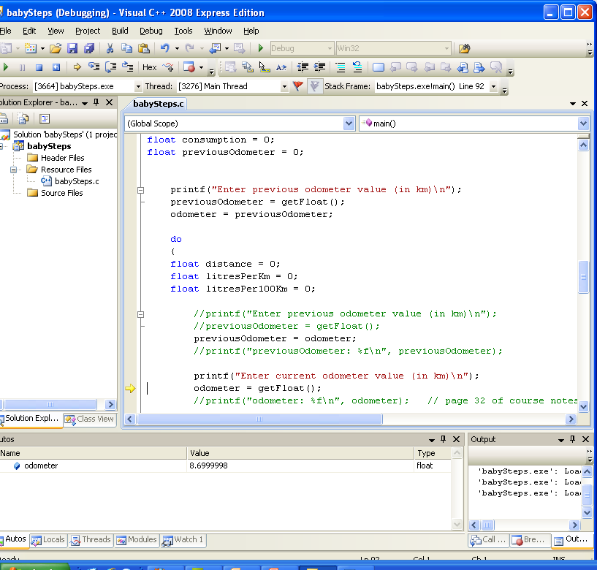
The yellow arrow indicates that the next line to be executed is this function call to getFloat().

Slide 19
In the previous example:
choosing Step Into will go to the first line of getFloat()
choosing Step Over will get a floating point value using getFloat() and give control back on the next line after that call
choosing Step Out will run until the current function you’re in returns
choosing Start Debugging will run until the program ends (or something else you don’t know about happens)

Slide 20
Stop Execution of Code
A “breakpoint” is a line in the code at which execution of the code will stop when it is reached.

Slide 21
Click in the extreme-left margin to create a breakpoint

Slide 22
A small red circle
shows up

Slide 23
You can then Start Debugging and the program will run until the breakpoint is reached or the program ends normally

Slide 24
“Disable Breakpoint”
or
“Remove Breakpoint”
“Disable Breakpoint” keeps the breakpoint there but inactive.

Slide 25
When Debugging, the program can be in one of two states:
Debugging: you have control and can do things (e.g. Step, look at variables)
Running: the program has control and is executing

Slide 26
Your Running program can stop and go into debugging mode if any of the following happen:
the program reaches a breakpoint
you choose Stop Debugging under the Debug menu

Slide 27
Using breakpoints is one of your most important debugging strategies

Slide 28
e.g. if you want to run your program until you reach a certain line
Set the breakpoint
Start With Debugging
Operate your program normally. It will go into Debugging mode, giving you debugger control, when it reaches the breakpoint

Slide 29
NOTE: Visual C++ Execution
Visual C++ differentiates between Start Debugging and Start Without Debugging.

Slide 30
Both will run your program but Start Without Debugging will not stop at breakpoints.

Slide 31
Start Without Debugging is also the one that adds the “Press Any Key To Continue” at the end of program execution

Slide 32
Run To Cursor
A form of temporary breakpoint is Run To Cursor.
The program will run until it reaches a breakpoint or the line specified by Run To Cursor.
Key Shortcut: Ctrl-F10
This is not found on the Debug menu but is found in the Right-Click context menu

Slide 33
Being Done
You often have to restart your program while debugging.
Restarting is done using Ctrl-Shift-F5.

Slide 34
If you just want to stop debugging, use Shift-F5.

Slide 35
Looking At Variables
You can look at and change variables in memory as well.
Variables can be viewed in various debug windows.

Slide 36
Unfortunately, the IDE configuration only might only show those windows when you are actively debugging.

Slide 37
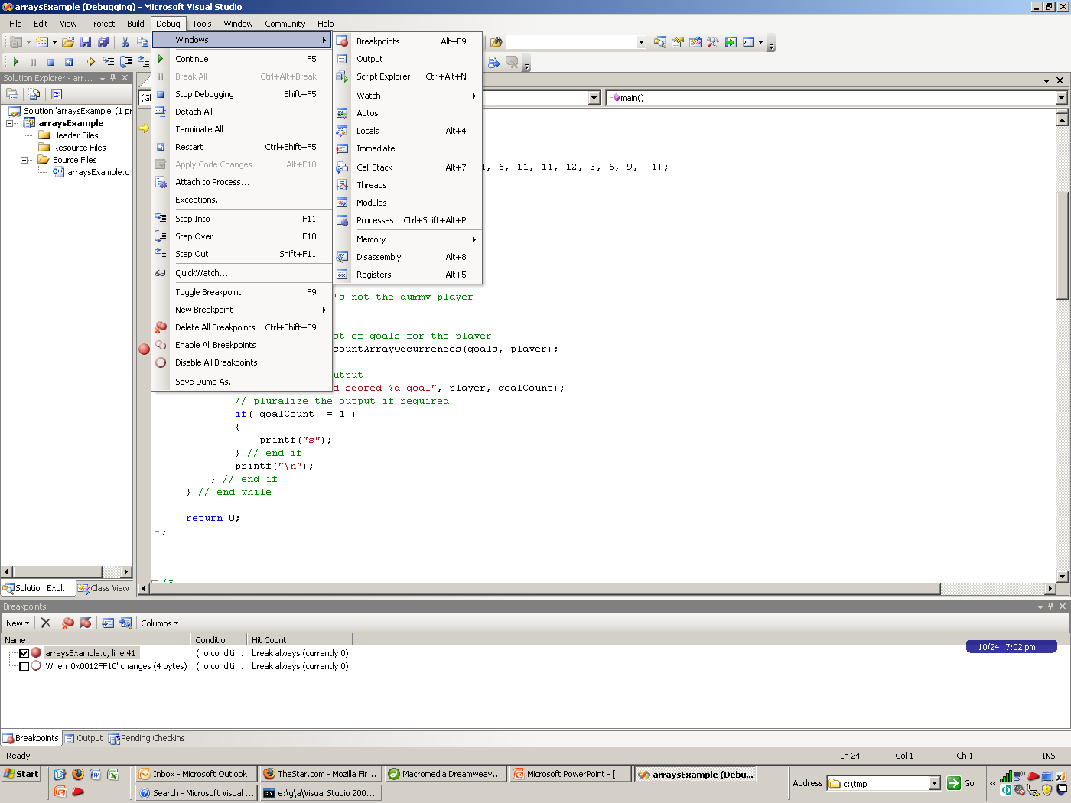

Slide 38
The Locals window shows the local variables and their values for the current function

Slide 39
Sometimes, though,
the variables you want won't be there

Slide 40
The Watch (or Watch 1) window allows you to list specific variables that you want to keep an eye on continuously

Slide 41
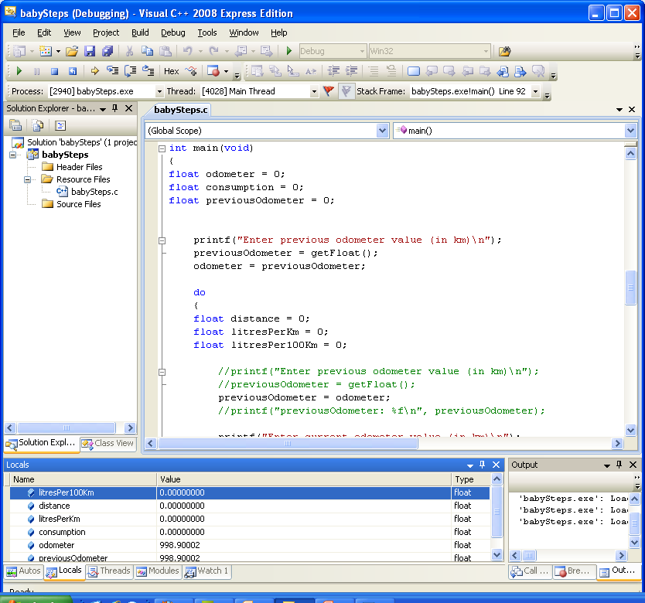

Slide 42
Variable values turn red if recently changed by the program.

Slide 43
You can change variable values simply by overtyping the value.

Slide 44
You can choose to watch specific variables in the Watch window.
Simply type the variable’s name in a Watch tab.

Slide 45
Be aware of scope, though

Slide 46
This is an incredibly valuable feature

Slide 47
Call Stack
The Call Stack is a window that contains a list of what functions you are currently in.
This can be very useful to determine how you got to the function that you’re in.

Slide 48
It also shows parameter values for each function call

Slide 49
The Call Stack window can be shown using Alt-7 (not Alt-F7).

Slide 50
You should be aware that …
If any Debug Windows are not available in the IDE, you can often access them using the Windows menu under the Debug menu.

Slide 51
But often you must be actually actively debugging to have access to them

Slide 52
Different IDEs
Most IDEs will have the basic capabilities described here.
They will usually have different ways of doing the operations, though.

Slide 53
Summary of Important VC++ 2010 Key Shortcuts
Operation | Shortcut
Start Debugging / Continue | F5
Step Over Function | F10
Step Into Function | F11
Step Out of Function | Shift-F11
Run To Cursor | Ctrl-F10
Restart | Ctrl-Shift-F5
Stop Debugging | Shift-F5

